Slide 1
About staying young
According to science

Slide 2






About me
Jesus Gonzalez vazquez
Jesus BASAIL

Slide 3
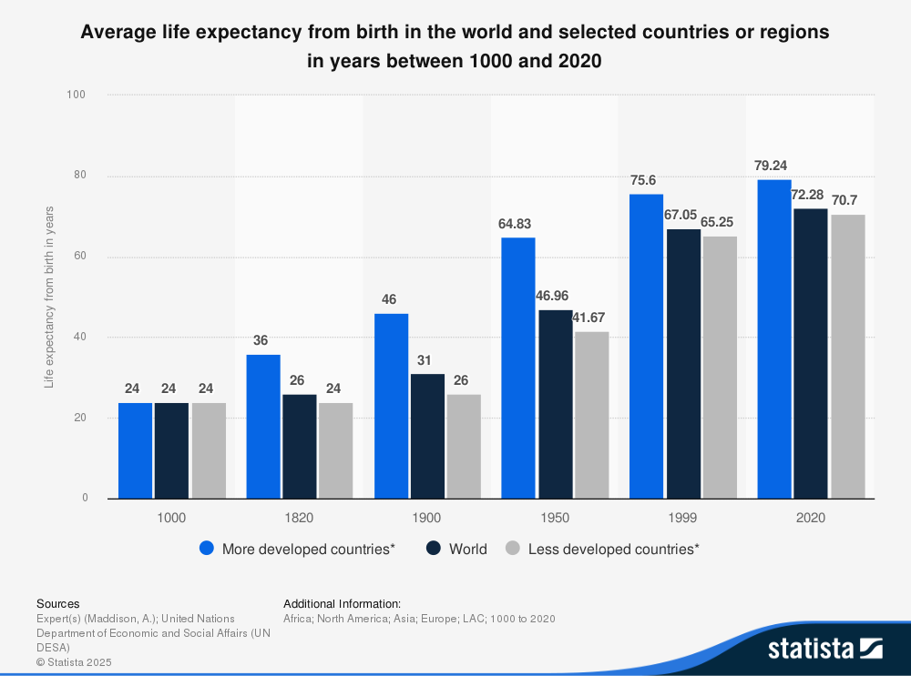
Longevity has been increased
Longevity vs Time

Slide 4
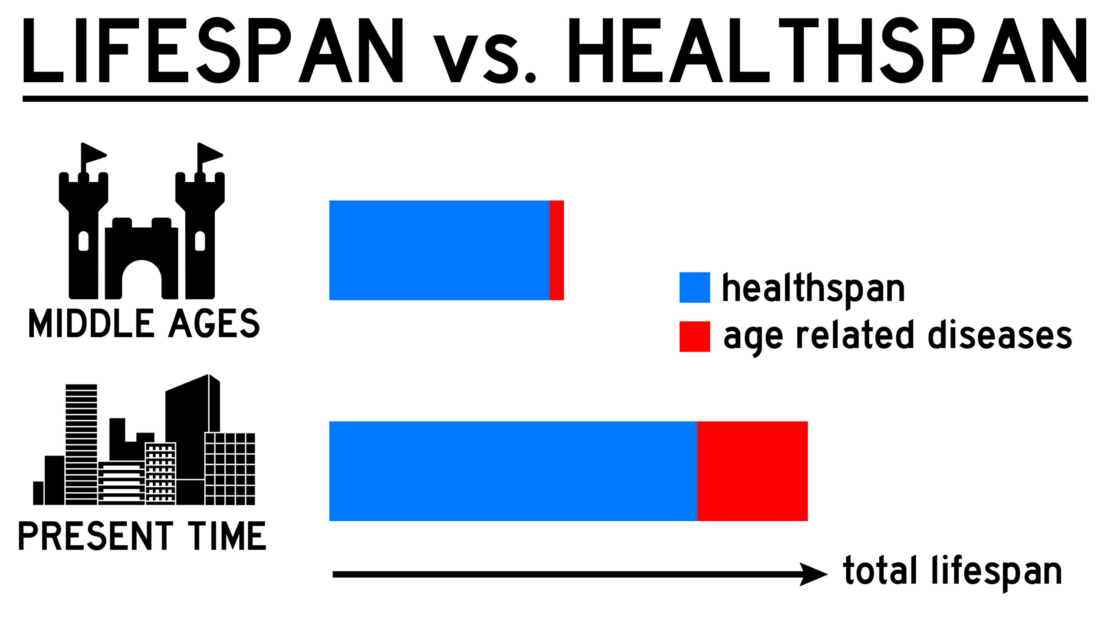
Healthspan Morbidity compression
Graph

Slide 5
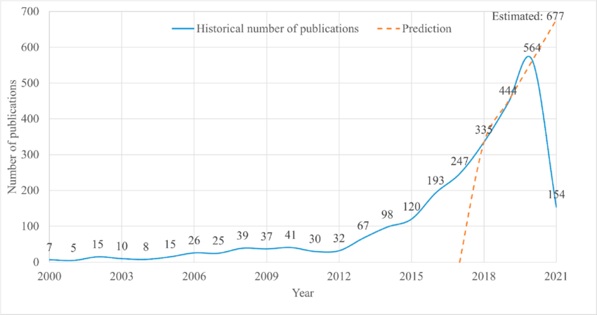
Information overload
Graph
Exponential publication findings

Slide 6
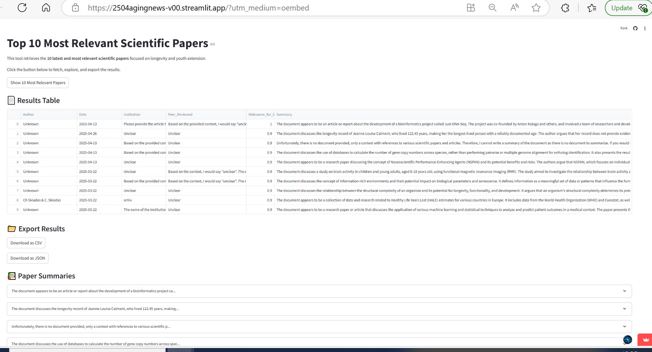
Our solution: App filtering
Pic app

Slide 7
Features & Functionality
Uses NLP, AI technology and DS principles
Takes real data from the web
Assigns relevance
Creates a summary of each document
On the press of a button
Displays a list with the most important info
Results can be downloaded

Slide 8
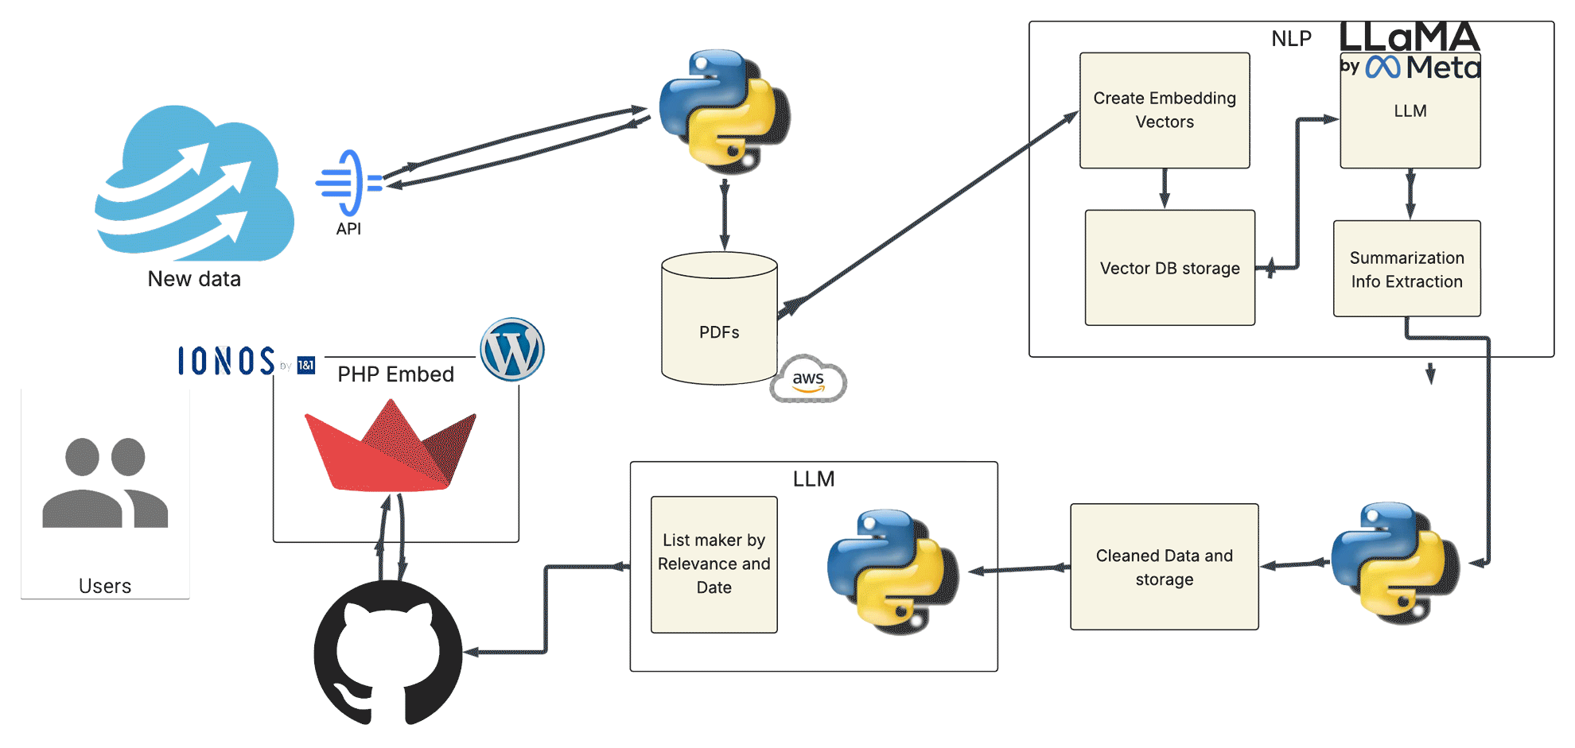
Our solution: Workflow

Slide 9
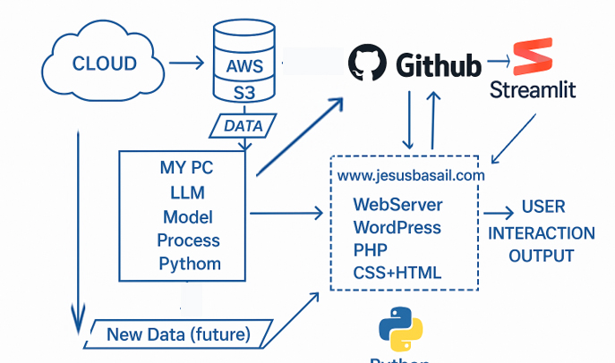
Tech Stack & Tools:
Data: Web Scraping APIs
Hosting: IONOS www.jesusbasail.com
Backend: PHP, Python, GitHub
Frontend: Wordpress / Streamlit
Engine: LLM: Meta-Llama-3-8B / all-mpnet-base-v2
Storage for Scraping: AWS- S3

Slide 10
Conclusion & Future Work

Slide 11
Future:
• Conclusion:
"Aging News provides valuable insights into how news evolves over time, offering users a new perspective on news consumption. The project has shown great potential for application in media companies, content managers, and data scientists."
• Future Work:
o Implement machine learning to predict news relevance in the future.
o Add more robust filtering options (e.g., based on region, publication, etc.).
o Explore ways to automate news categorization based on sentiment analysis.

Slide 12
Thank you, questions?
Jesus gonzalez vazquez
+49 160 807 6571
email@jesusbasail.COM
WWW.jesusbasail.COM

Slide 14
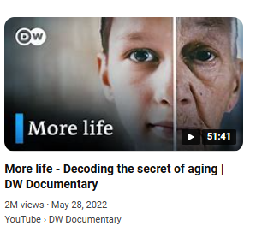
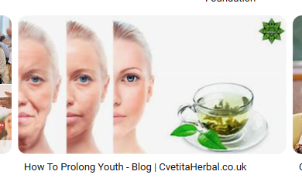
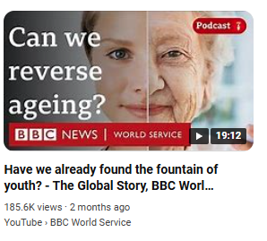
Problem:
Growing interest on longevity
Scientific contribution frequency
Challenges of information overload
Importance of reliable research
Rise of dietary supplements
Claims of the fountain of youth

Slide 15
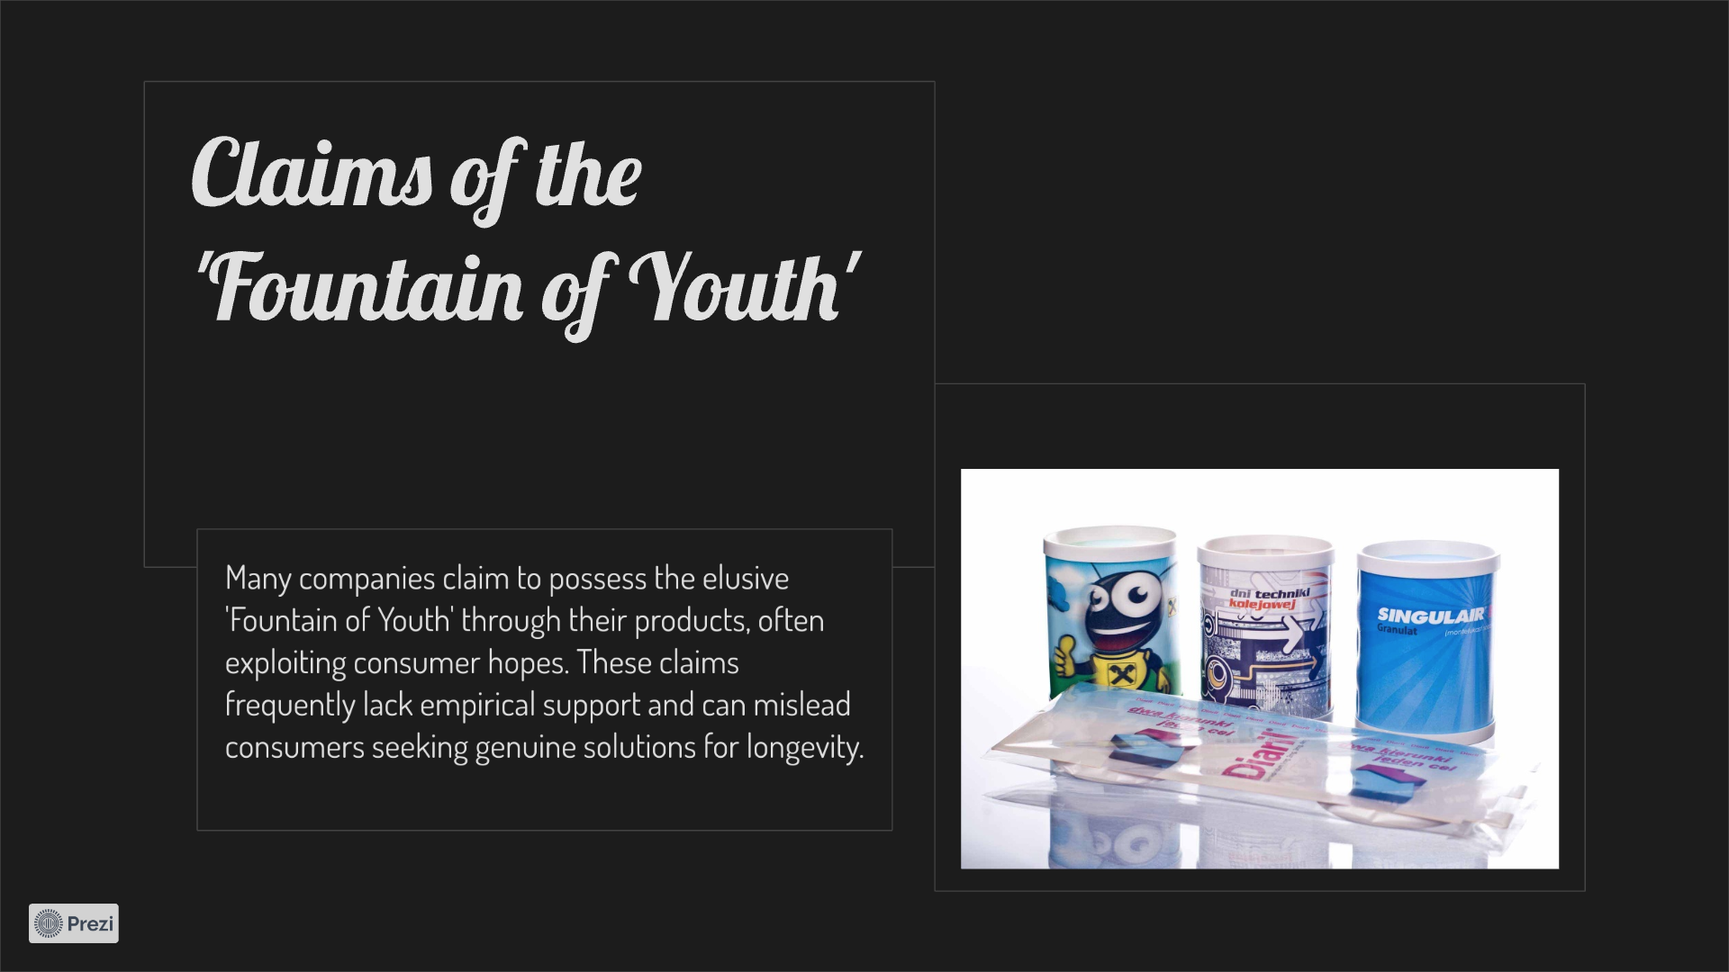
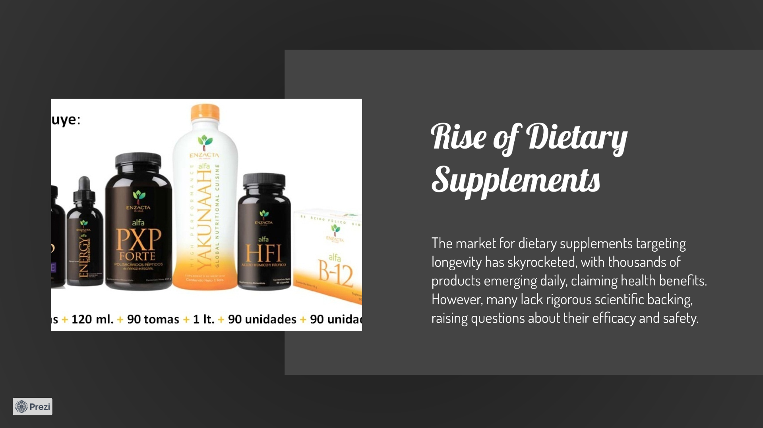
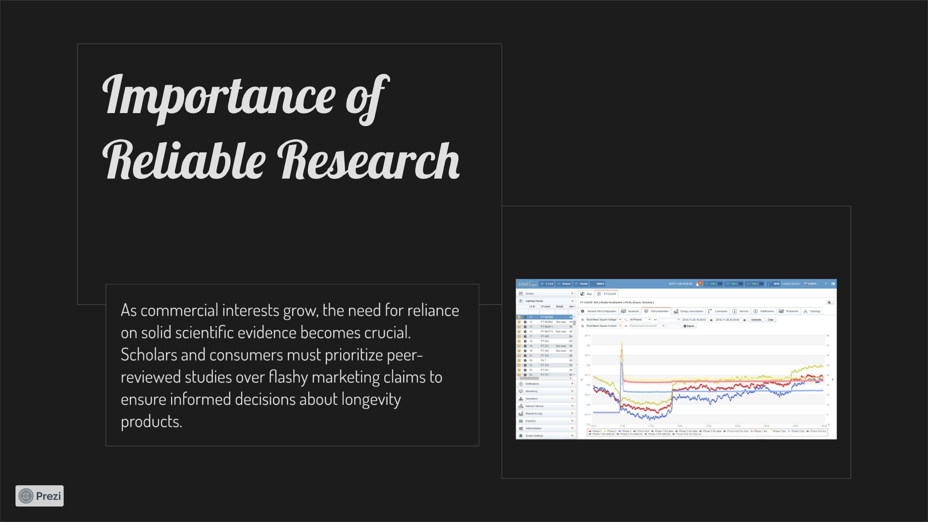
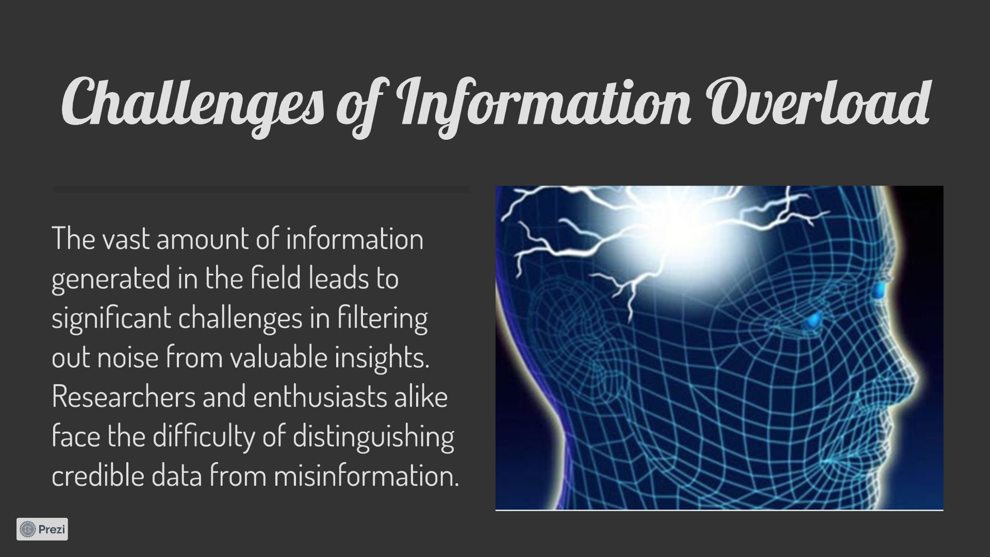
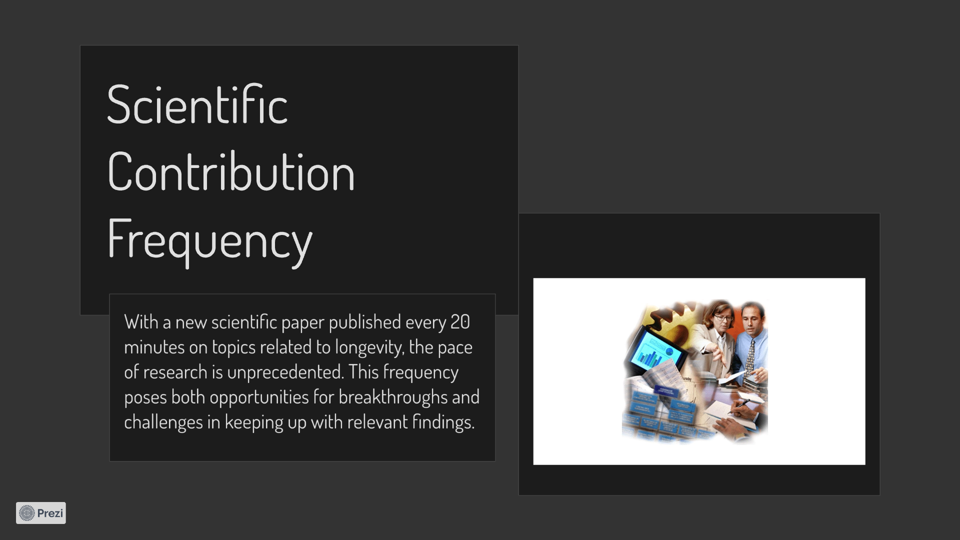
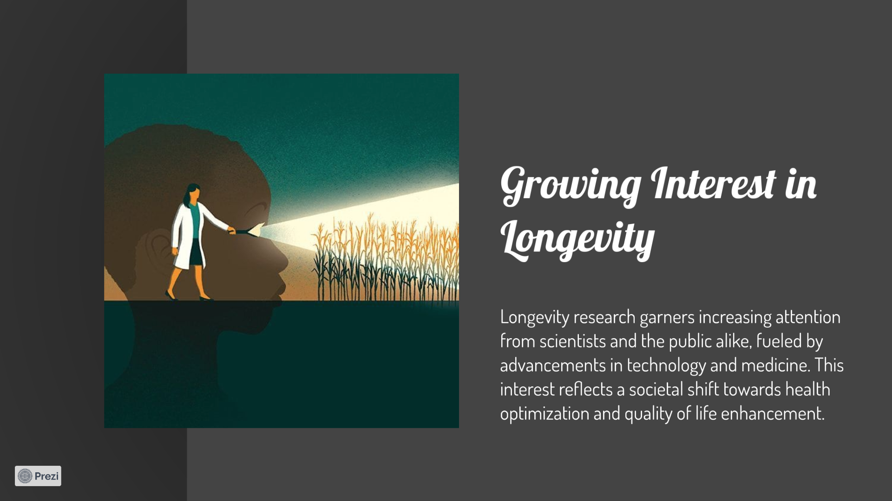
Problem:
Growing interest on longevity
Scientific contribution frequency
Challenges of information overload
Importance of reliable research
Rise of dietary supplements
Claims of the fountain of youth
prezi

Slide 16
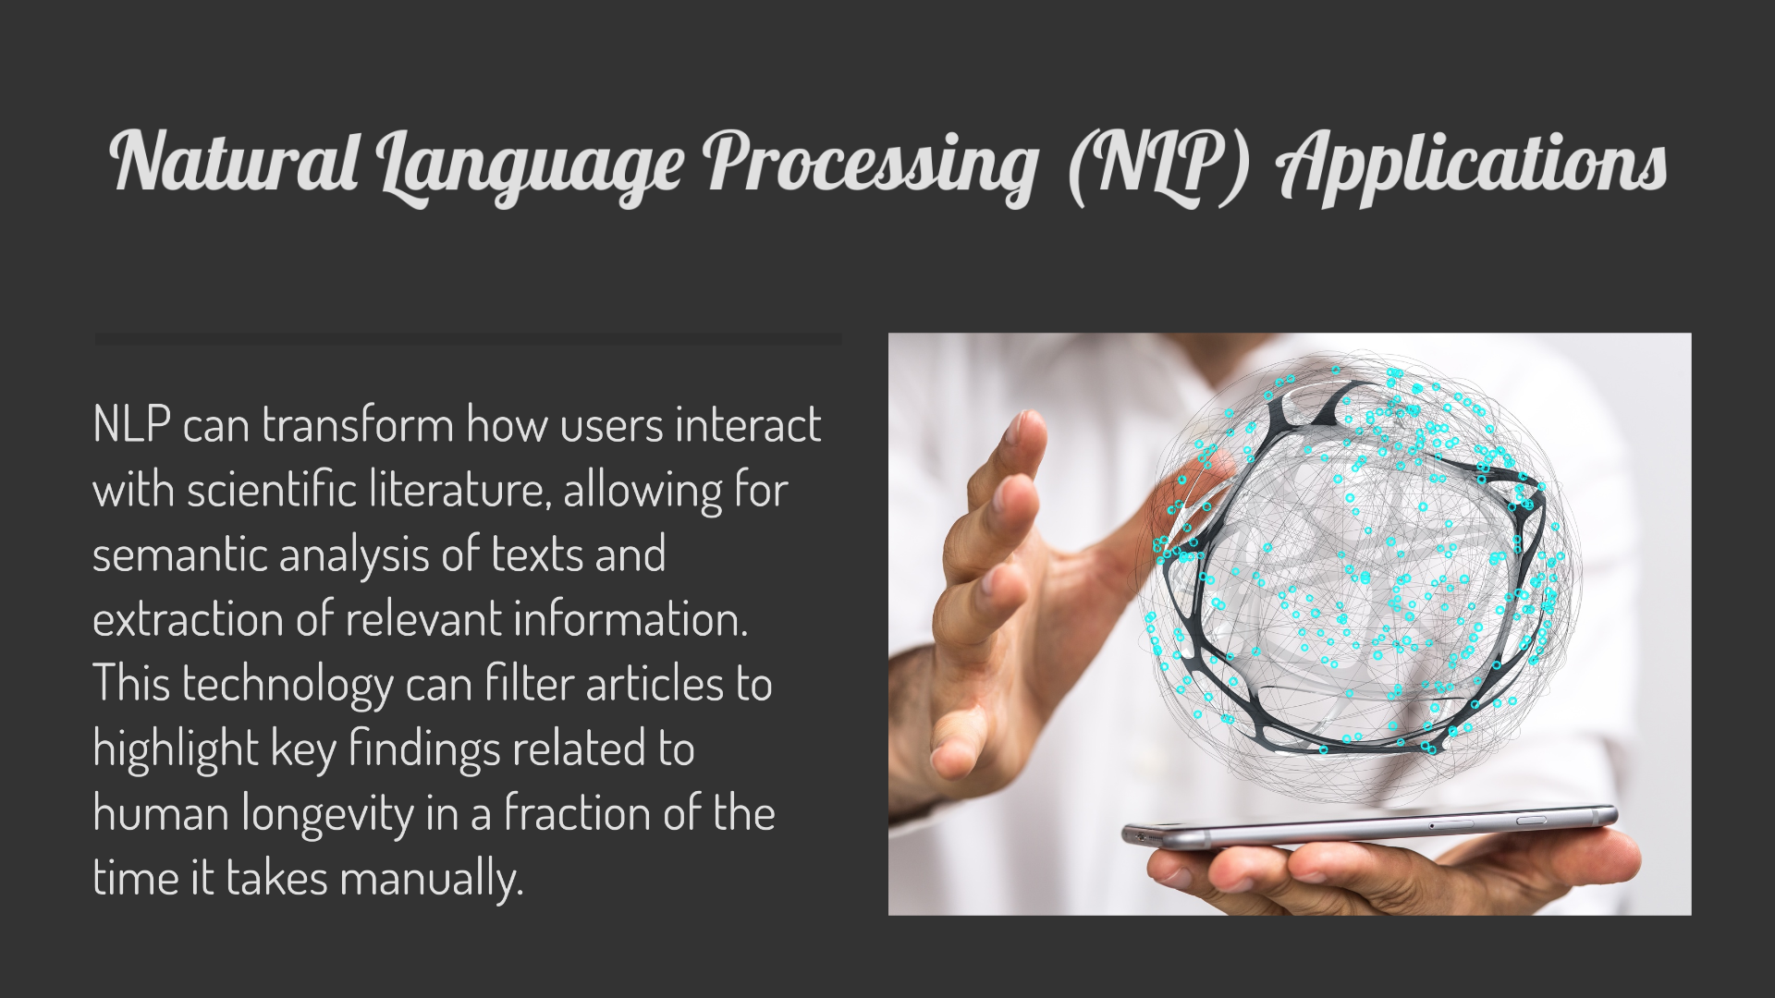
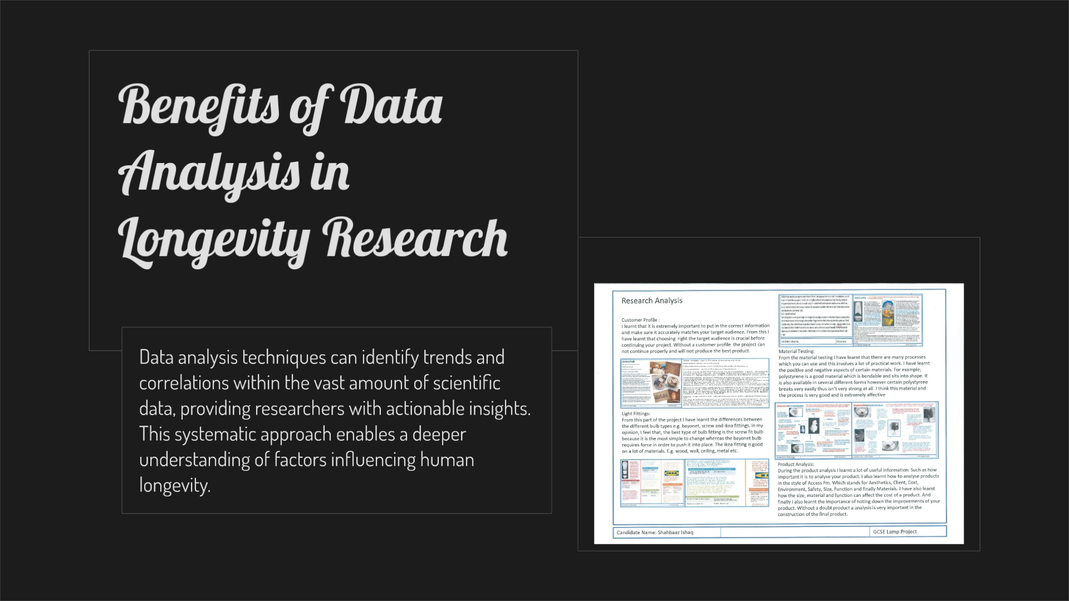
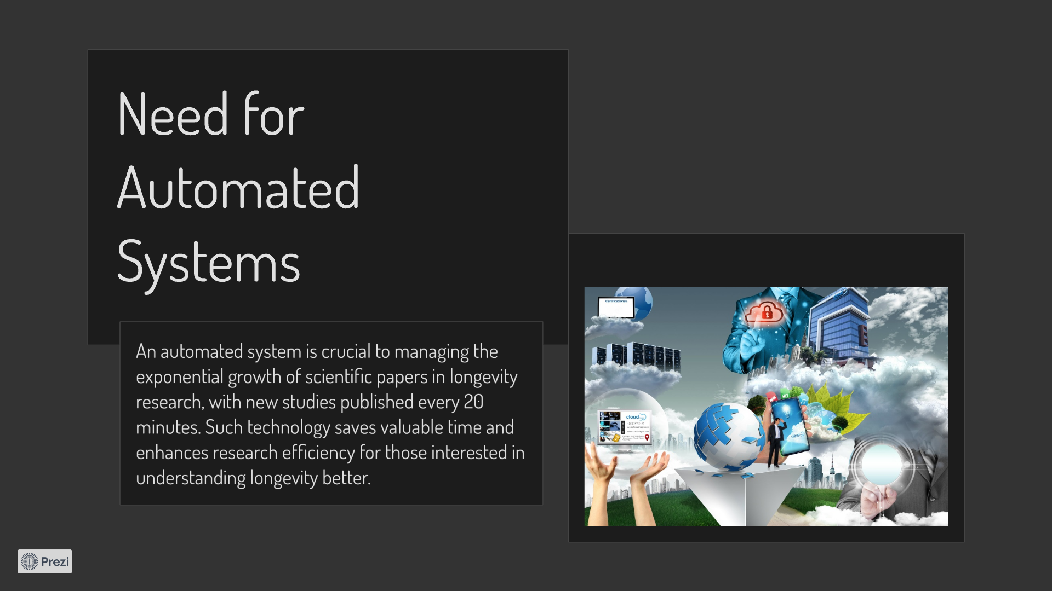
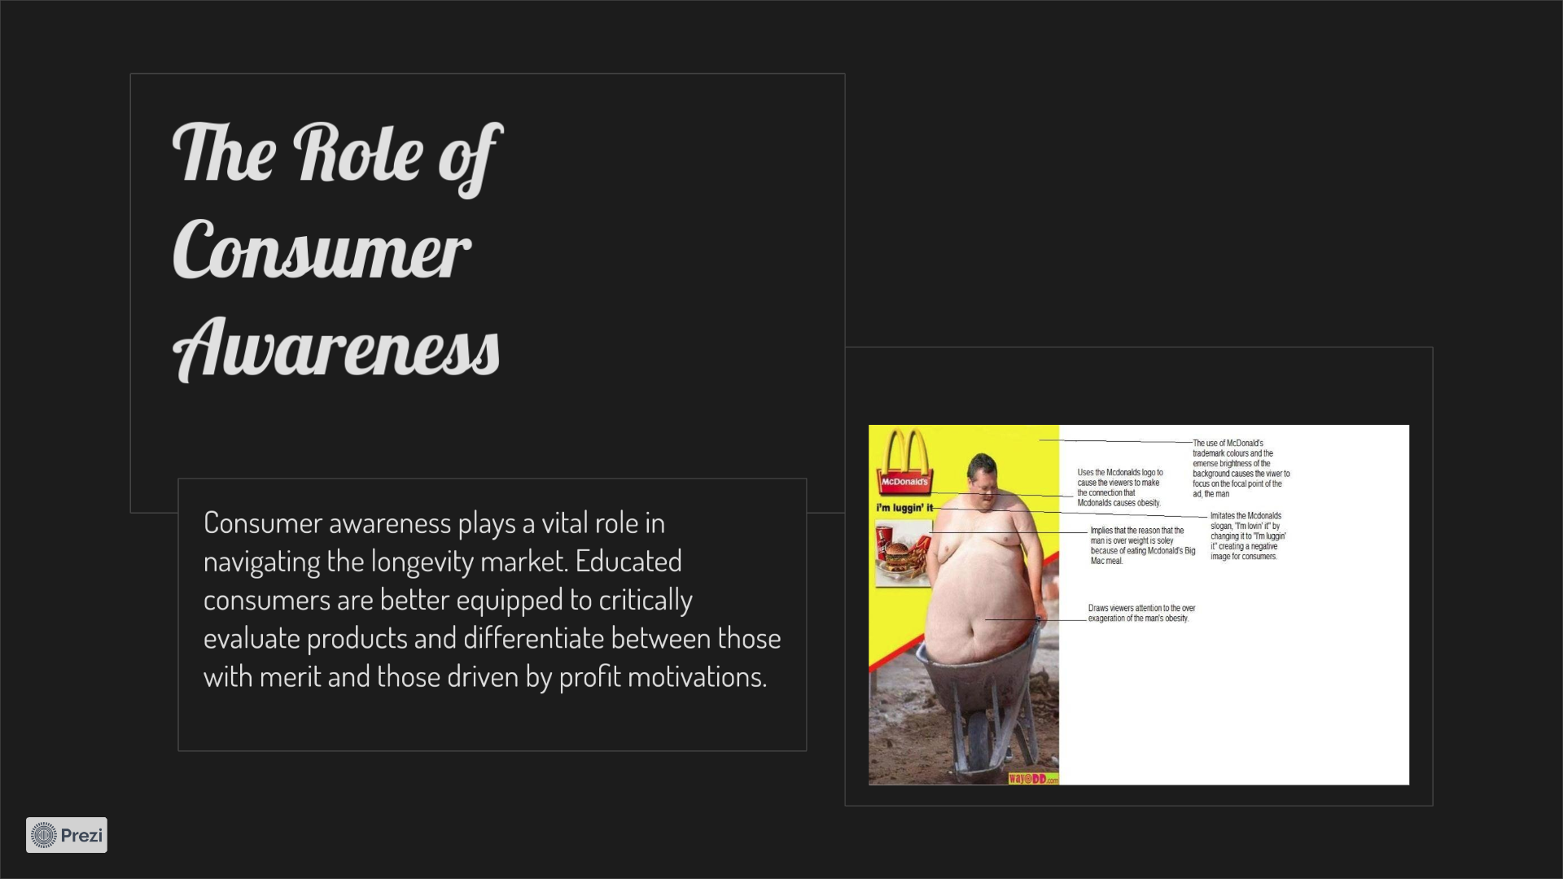
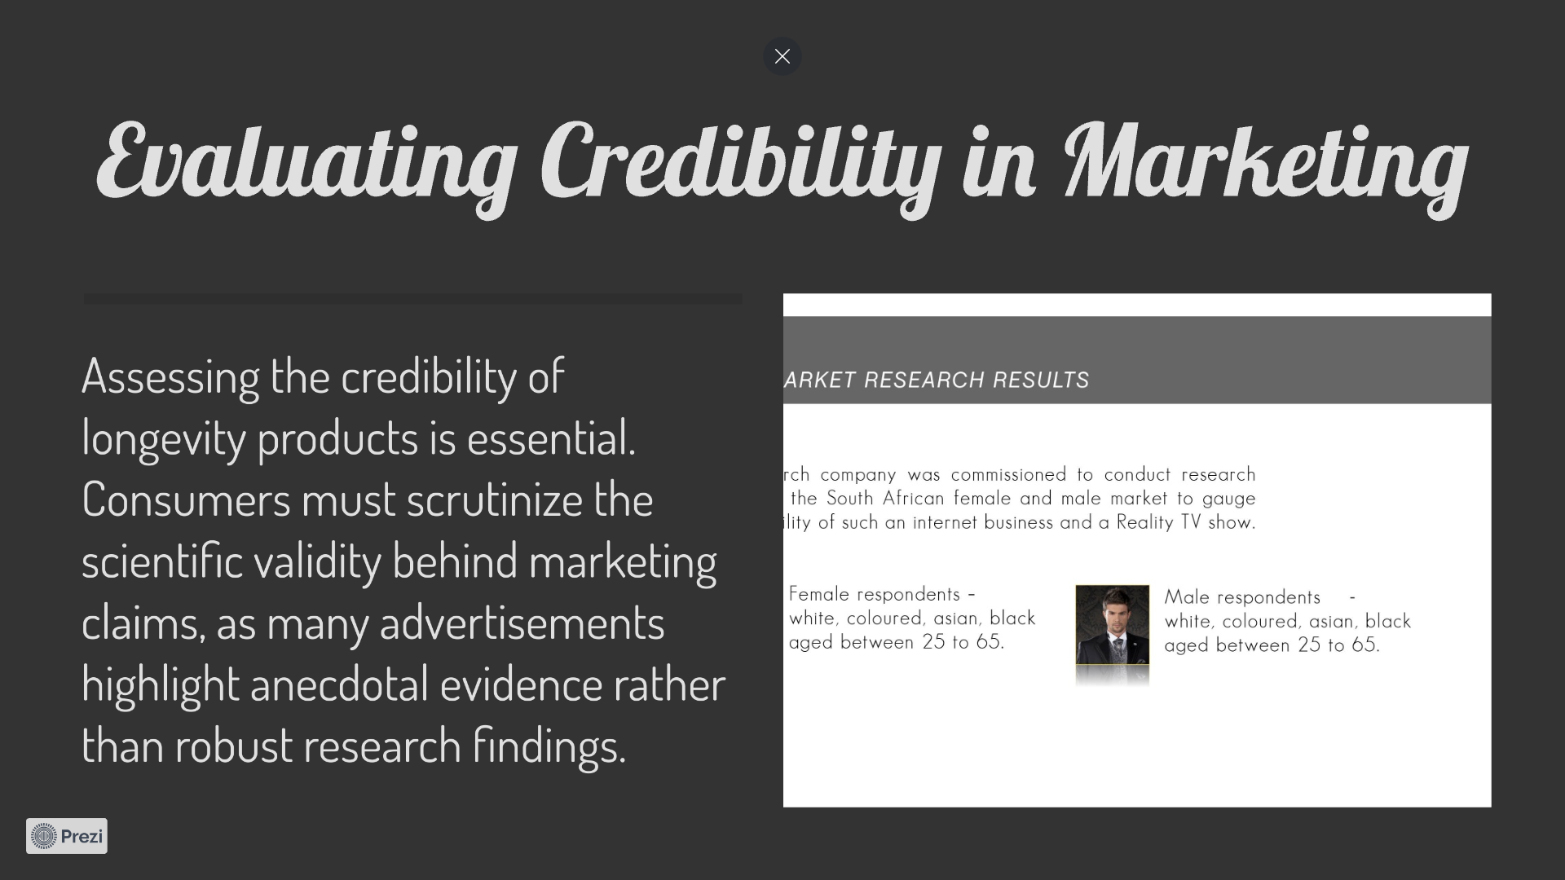
Solution:
Evaluating credibility in marketing
The role of consumer awareness
Need for automated systems
Benefits of data analysis in longevity research
NLP applications

Slide 17
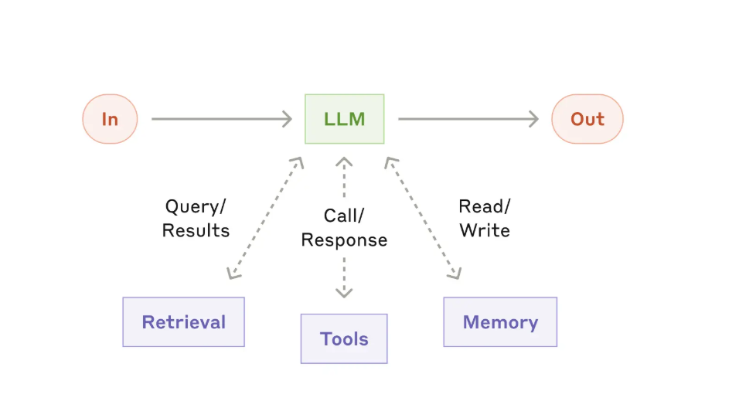
Code & Technical Details

Slide 18
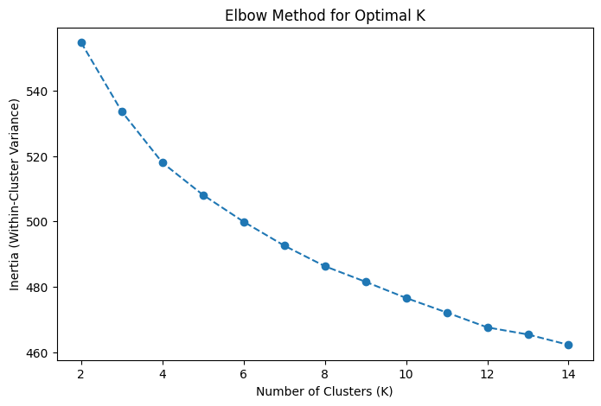
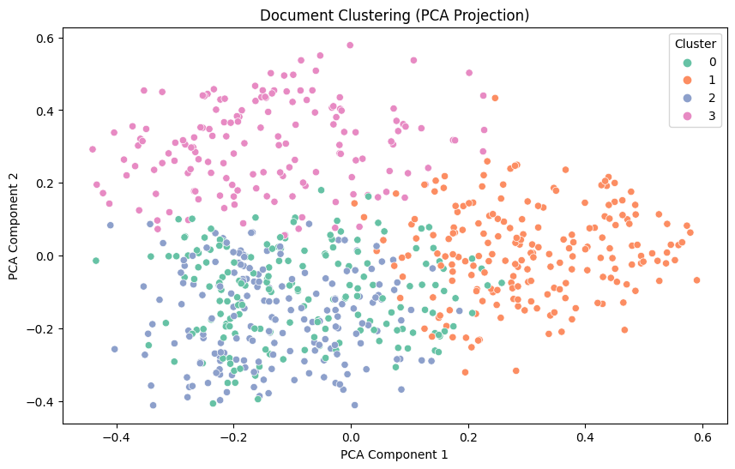
Code & Technical Details
Content:
• Code Snippet:
"Here’s a simple function that fetches news articles based on a specific keyword and tracks the number of shares and comments over time."
• def fetch_news_data(keyword):
• # Fetches articles based on the keyword and analyzes user engagement
• articles = get_articles_from_api(keyword)
• for article in articles:
• analyze_engagement(article)
• return articles
• Challenges:
o Challenge 1: Scraping data from dynamic websites with JavaScript content.
o Solution: Used Selenium with Python to dynamically load JavaScript-based content.
o Challenge 2: Managing the aging data (especially in terms of user engagement over time).
o Solution: Created an algorithm to monitor the number of shares, comments, and other engagement metrics over set intervals.

Slide 19
Our contribution: Extending Youth Scientifically
A data science and AI based application that filters scientific information and articles from multiple sources and helps to classify, summarize and assigns relevance to these articles, which can change over time, providing insights into longevity news and understands audience interest

Slide 20
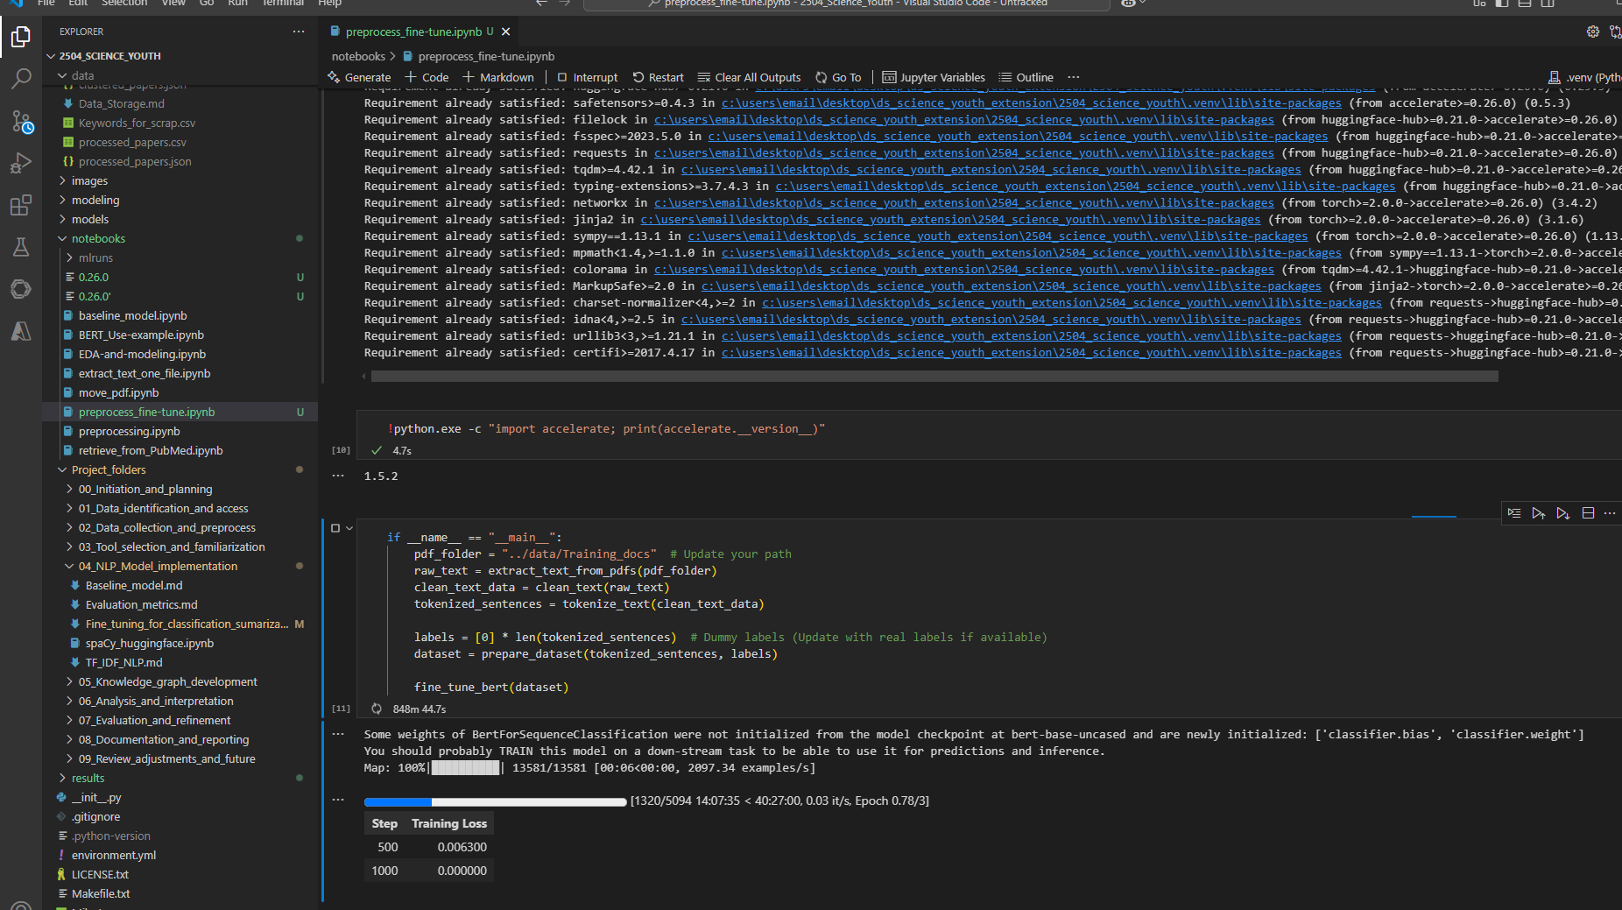
Code & Technical Details

Slide 21
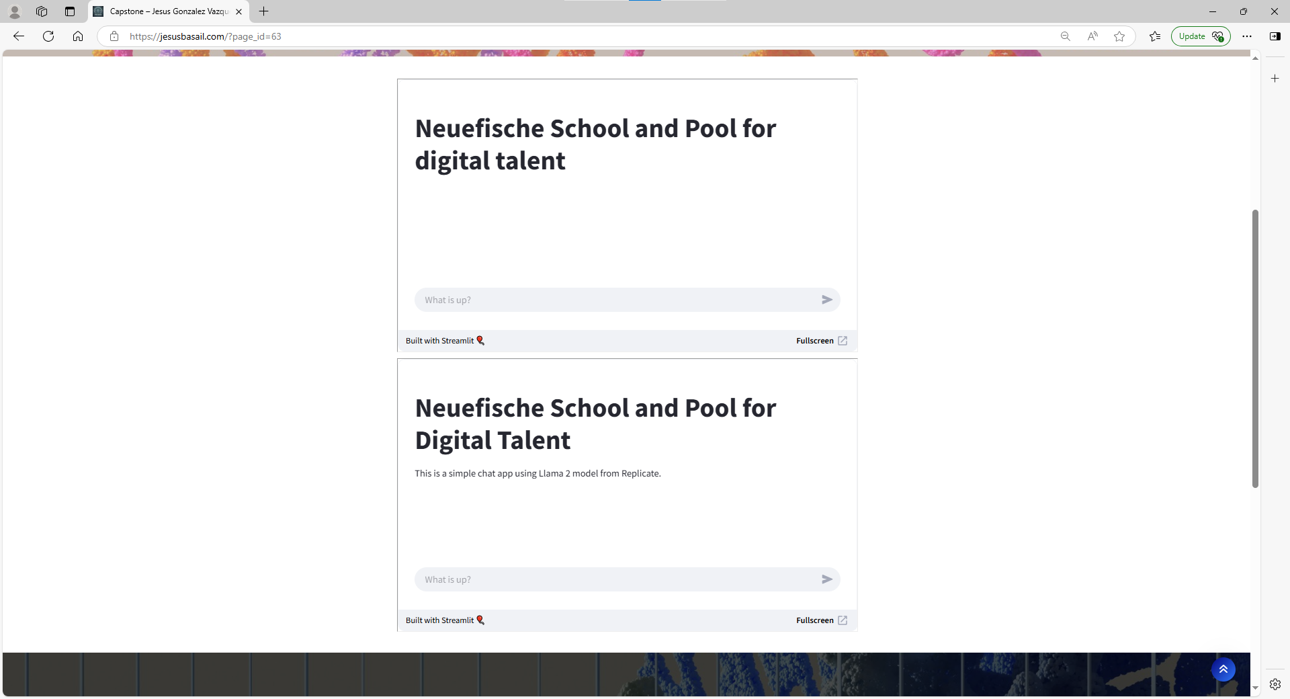
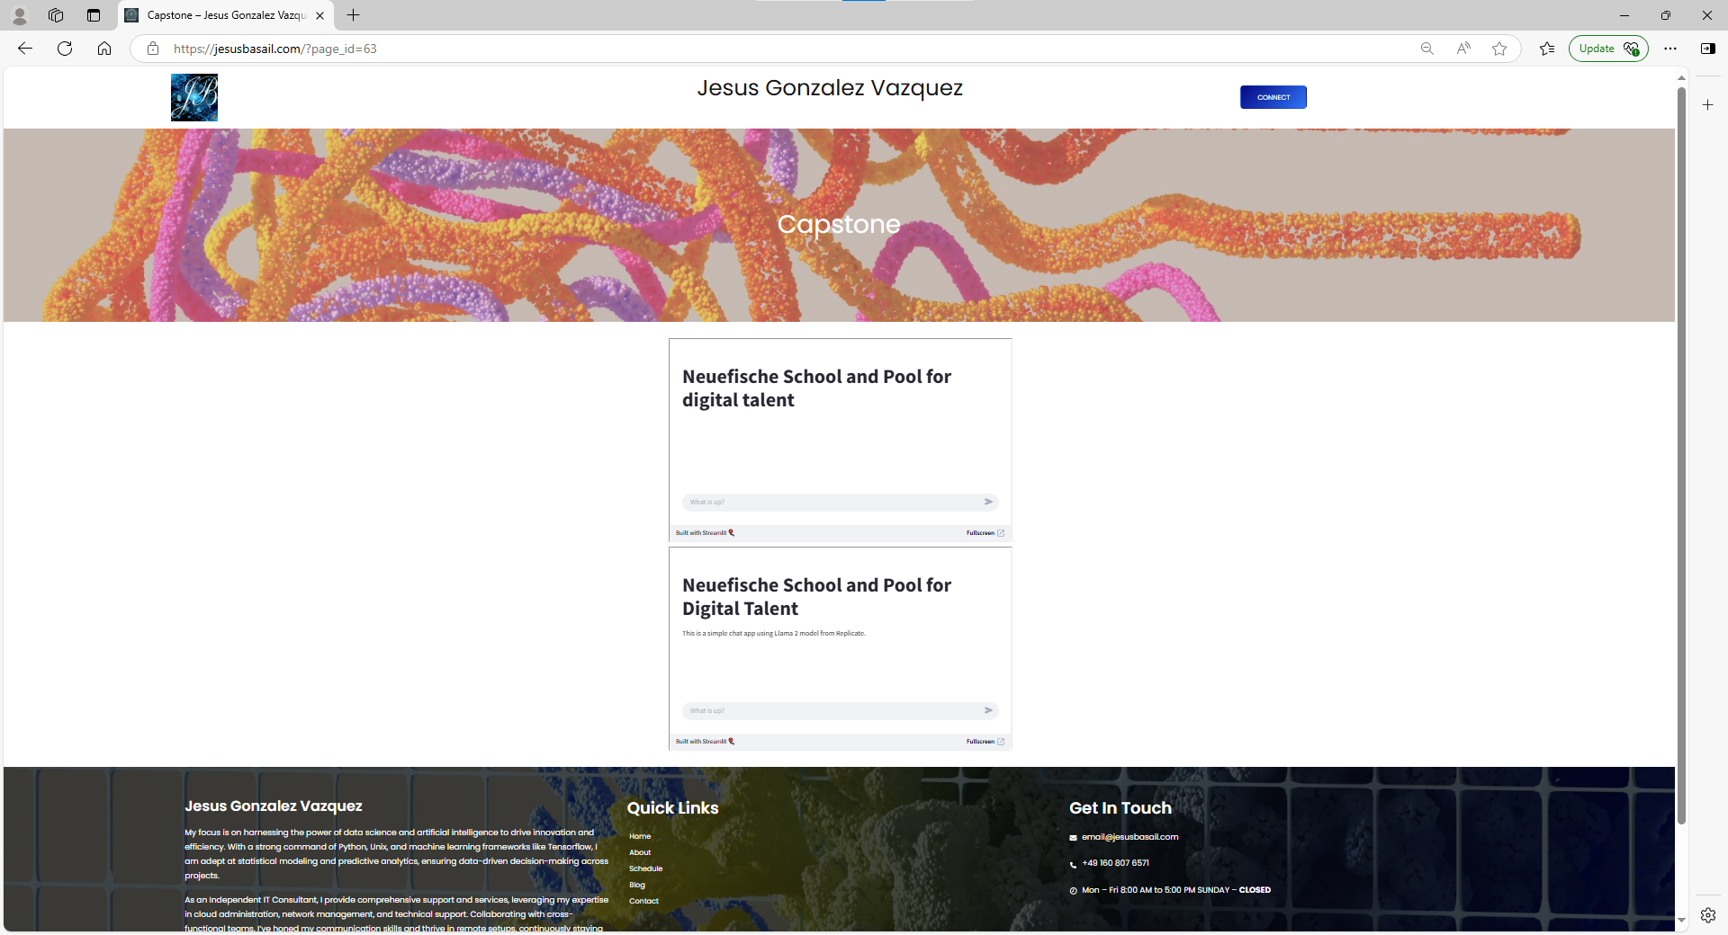
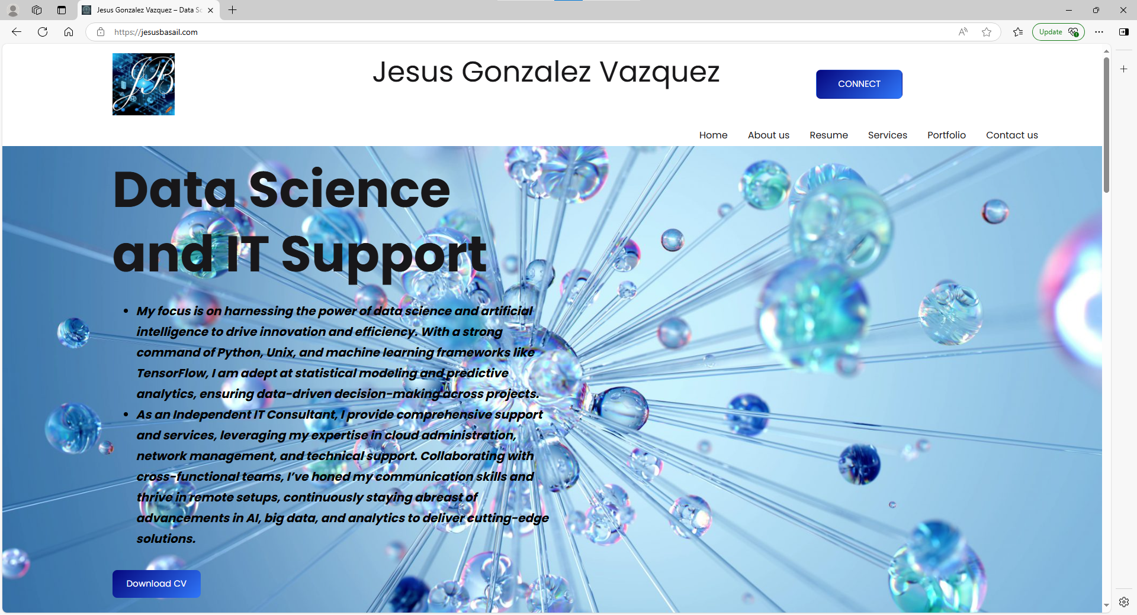
Results / Outcomes
Jesus Gonzalez Vazquez – Data Science and IT Support

